Slide 1
LOOPS

Slide 2
LOOPS IN R
repeat
for
while

Slide 3
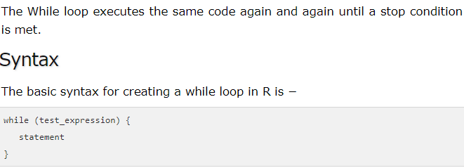

Slide 4
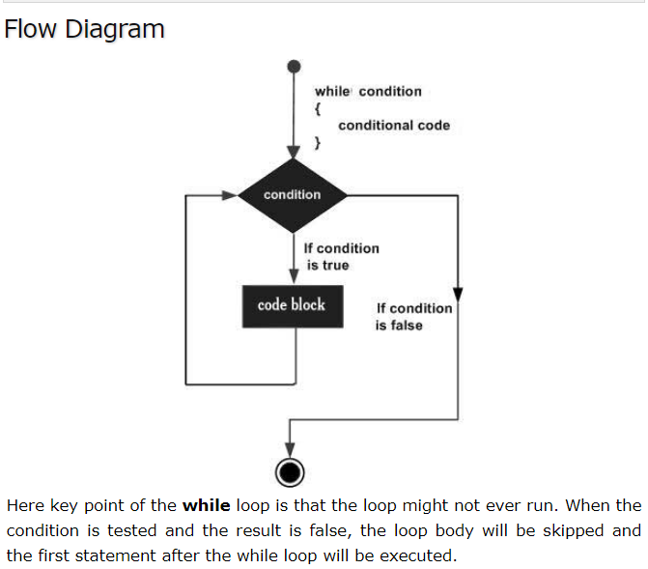

Slide 5
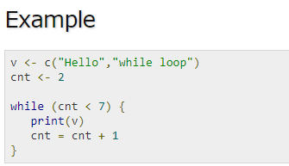

Slide 6
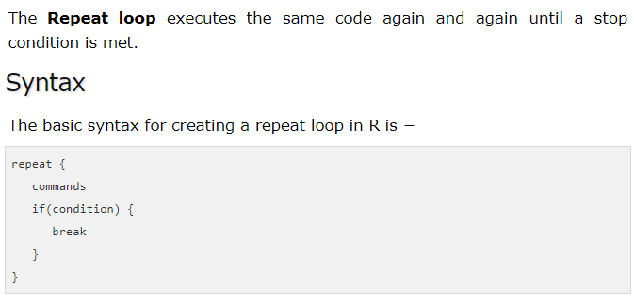

Slide 7
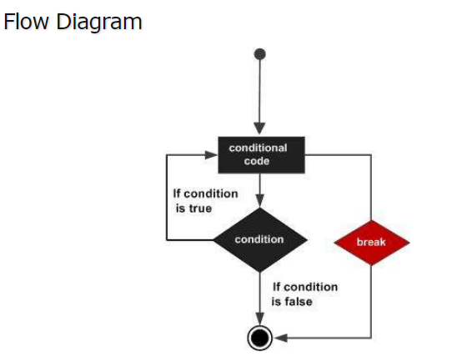

Slide 8
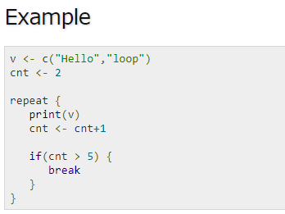

Slide 9
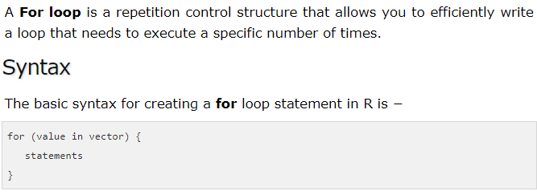

Slide 10
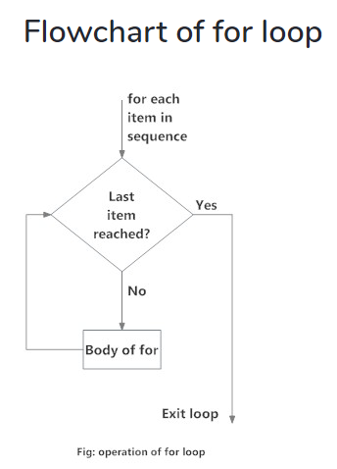

Slide 11
Find COUNT OF even numbers in the following list using for loop
2,5,3,9,8,11,6

Slide 12
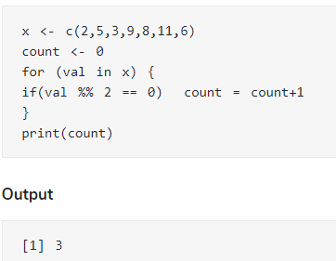

Slide 13
Practice Questions
Find factorial of a number using for loop
Write a code for multiplication table
Write a code for prime number

